Slide 1
Wayfair ecommerce
Group 6 Final project
Yinyin Ye, Xinglong Jia, Himanshu Gupta

Slide 2
Overview
Today, the home furniture market has exploded to over $600 billion in the U.S and Europe, and Wayfair is the largest company in the space. Wayfair understood that home goods e-commerce required a different buyer experience than other retail goods, and developed proprietary data science and visualization technologies specifically suited towards meeting this need.

Slide 3
Goal
To analyze the Wayfair ecommerce clickstream data, potentially in combination with supplementary datasets, in order to increase the understanding of how various factors influence purchasing patterns on the Wayfair online platform

Slide 4
EDA

Slide 5
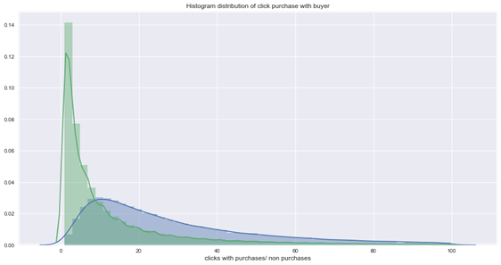
Clickthrough Buyers v/s Non-Buyers
Buyers clicks more on an average than non- buyers

Slide 6
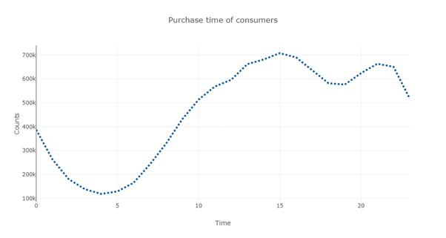
BUYING HABITS
Customers clicks peaks at 3 pm to 11 pm , means after office hours.

Slide 7
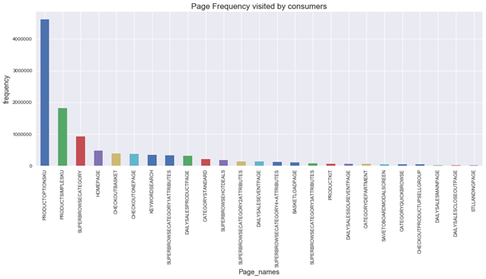
CONSUMER BEHAVIOUR USING PAGE VIEWS:
Insights: .People have clicked Products options more often than HotDeals page.
Reasons: It means two things either the people are not concerned in paying more money for paying when buying from Wayfair. or the Hot Deals page deals does not attract customers.

Slide 8
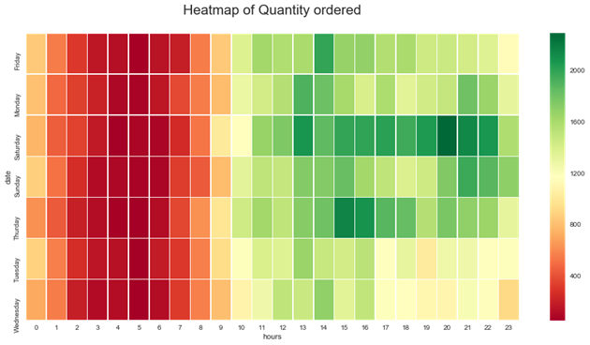
BEST DAY AND TIME FOR ORDERING BASED ON QUANTITY?
1. Saturday is the best day for ordering and most appropriate time is 8 pm.
2. 1 pm to 11 pm is prefered time for ordering.
3. Friday and Thursday are second best days to order.

Slide 9
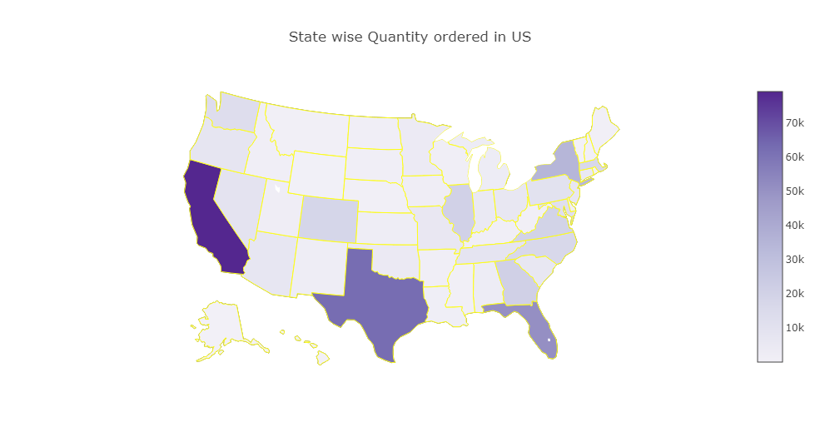
STATES PREFER BUYING FROM WAYFAIR?
People orders maximum quantities on Saturday and time varies from 3pm to 10 pm.

Slide 10
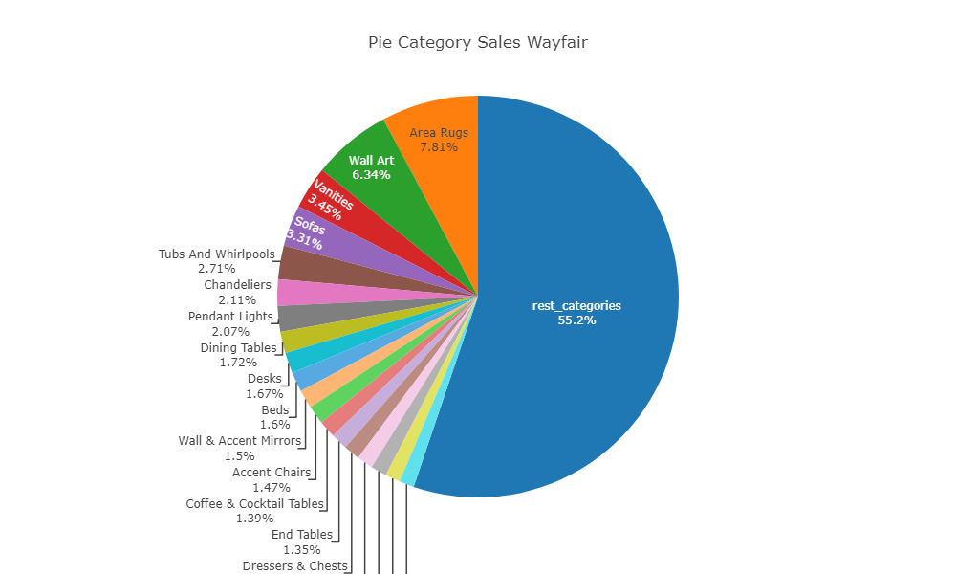
WAYFAIR TOP 20 CATEGORIES SALESWISE
Area Rugs, Wall Art, Vanities, Sofas, Tubs & Whirlpools are the top 5 categories.
Wayfair sells products in almost 900 categories. From the pie chart top 20 categories sales contributes the 45% of the sales and rest 880 categories contributes the rest 55% of the sales.

Slide 11
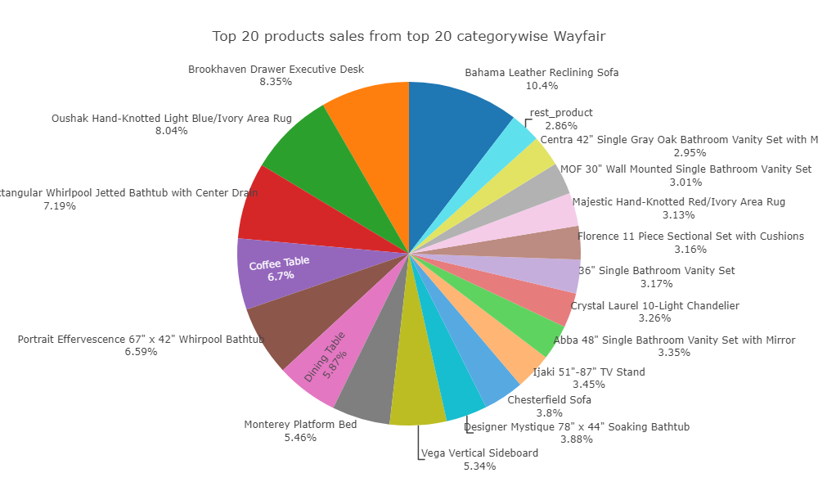
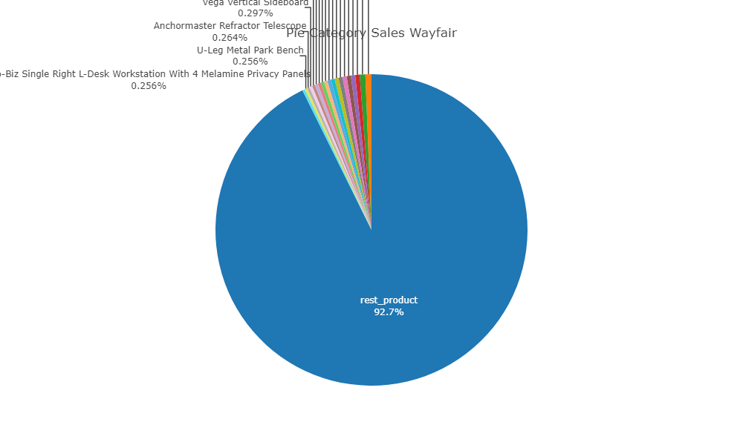
Top 20 Product overall v/s Top 20 products in Top 20 categories

Slide 12
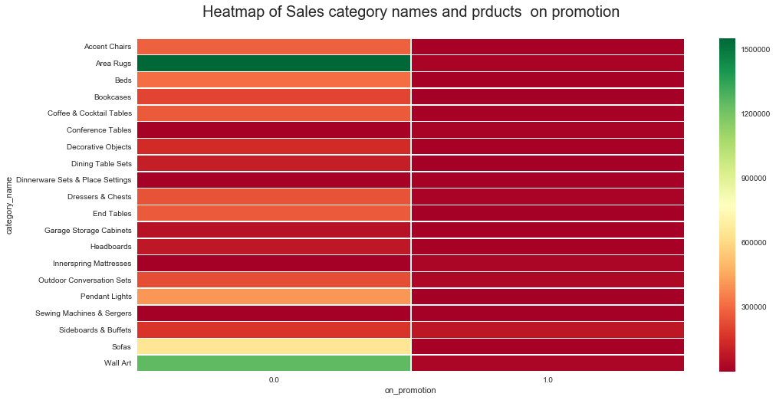
CATEGORY SALES BASED ON PROMOTION
1. Products which were top sellings little less in demand during non promotion..
2. Wall Arts and Area Rugs looks outliers.
3. Other products maintained the trends of selling heavily during promotion offers.

Slide 13
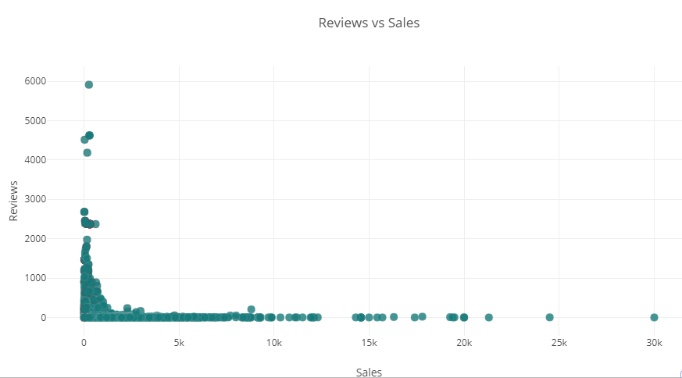
DOES REVIEWS IMPACT SALES

Slide 14
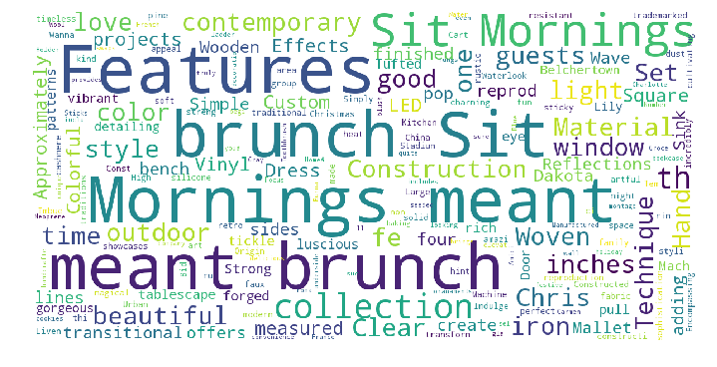
MOST RELEVANT WORDS IN PRODUCT DESCRIPTION

Slide 15
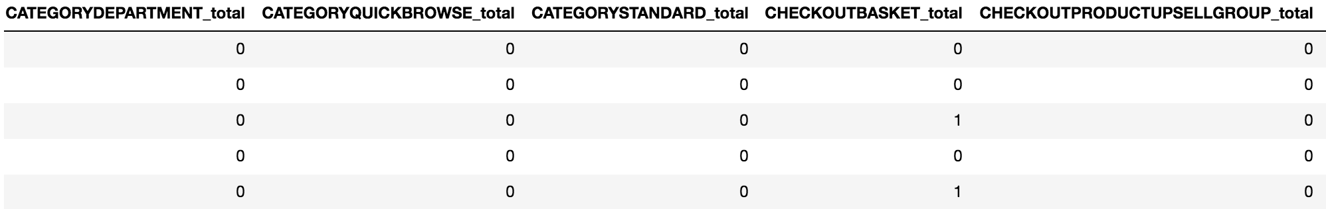
Classification - Data modification
Create a new target variable (final_ordered_total): For the data in the table clickstream_with_purchase, set to 1, and for the data in the able clickstream_without_purchase, set to 0.
Dummy variables:
Since we want to know the customer behavior pattern on clickstream, we group by [ customer_id, date, time] and get the aggregate sum for individual web pages
Date variable: ‘2018-07-16’ -> ‘Monday’/ ’Tuesday’
Time variable: ‘17:12:15’ -> ‘afternoon’ / ’morning‘...

Slide 16
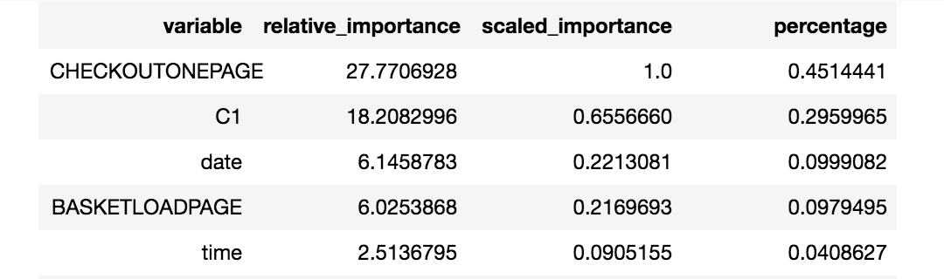
Data Modification
Further modification for the data when we find out one variable ‘CHECKOUTONEPAGE’ plays a huge role in our model and the result depends too much on it.
We remove the column ‘CHECKOUTONEPAGE’

Slide 17
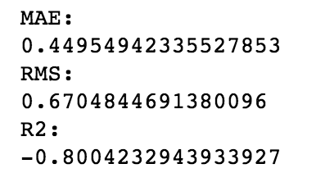
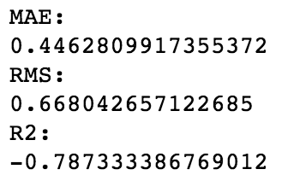
Prediction on customer behavior
Classification : to see whether there is a pattern for customer to click on different page, the time they click the web pages relate to the final purchase
Logistic Regression - Neural Network
The negative r ^2 suggests both models do not fit our data
Thus, we move to autoML tool to see which model is going to work better for our data set

Slide 18
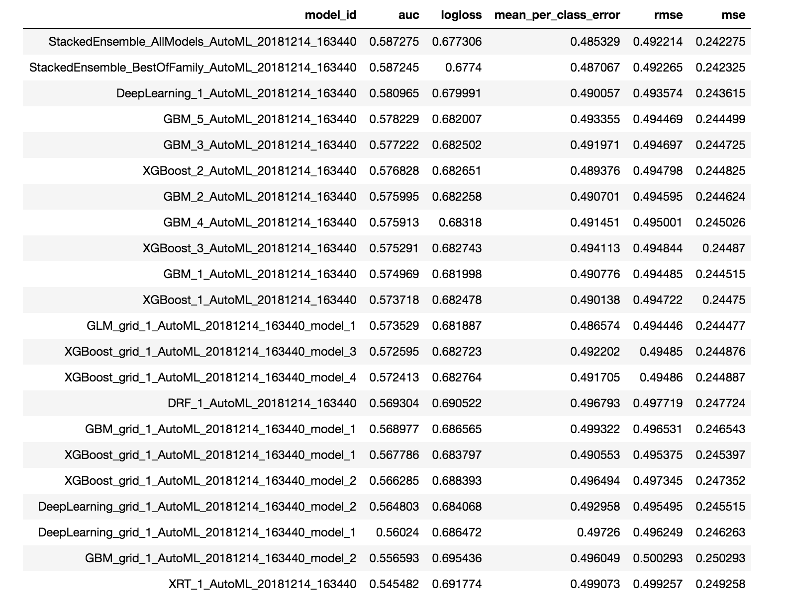
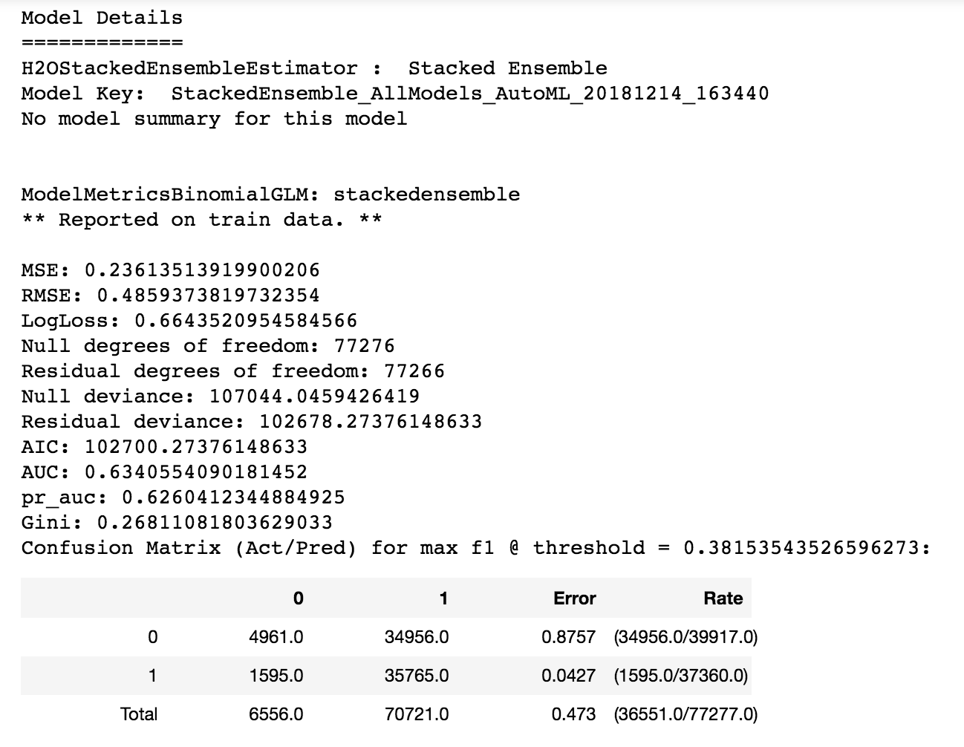
AutoML for classification (H2O)

Slide 19
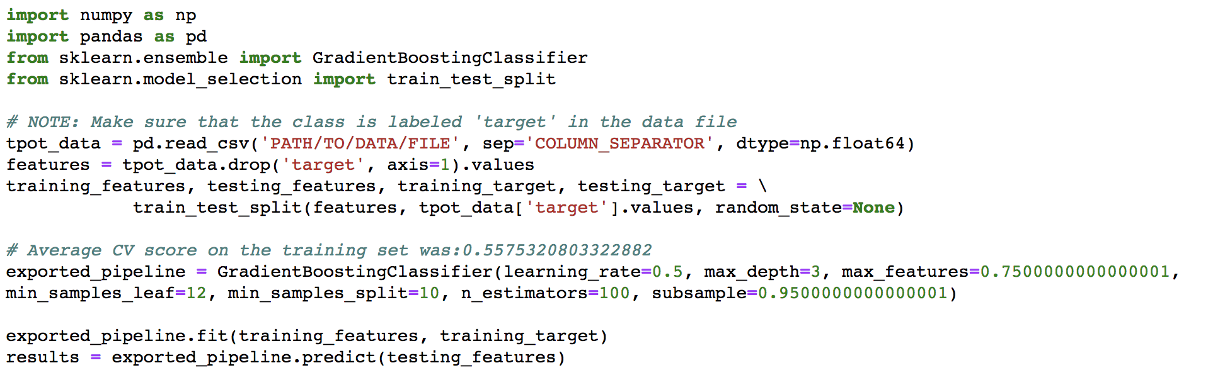
AutoML for classification (Tpot)

Slide 20

SALES PREDICTION

Slide 21
STEPS IN SALES PREDICTION
DATA CLEANING & PREPROCESSING
FEATURE ENGINEERING
VARIABLE SELECTION
MODELLING
TESTING

Slide 22
DATA CLEANING, PREPROCESSING AND CLEANING
DATASETS USED: WAYFAIR PRODUCTS, ORDERS AND TAXES.
DATA CLEANING: Joined all three datasets based on PRODUCT_ID AND ZIPCODE AND remove all NA values from dataset..
FEATURE ENGINEERING: After joining we have 21 variables. Further we created 5 more variables to make model more effective in prediction.
CATEGORY RATING Based on sales.
MANUFACTURER RATING based on sales
DESCRIPITION RATING based on high frequency words in product description
Converted time into Morning, Afternoon, Evening, Night.
Converted date into Weekdays.
Created NSM to signify the number of seconds from midnight.

Slide 23
MODEL FINAL PREDICTORS: quantity_ordered, weight, num_reviews, onsite_price, on_promotion, num_return, NSM, Friday, Monday, Saturday, Sunday, Thursday, Tuesday, Wednesday, Afternoon, Evening, Morning, Night, description_length, category_count, manu_count, category_rating, manufacturer_rating, index, Desc_rate.

Slide 24
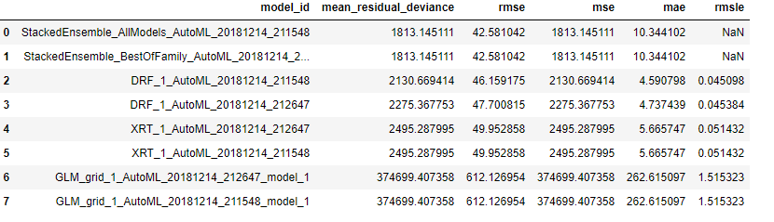
AUTOML H2O

Slide 25
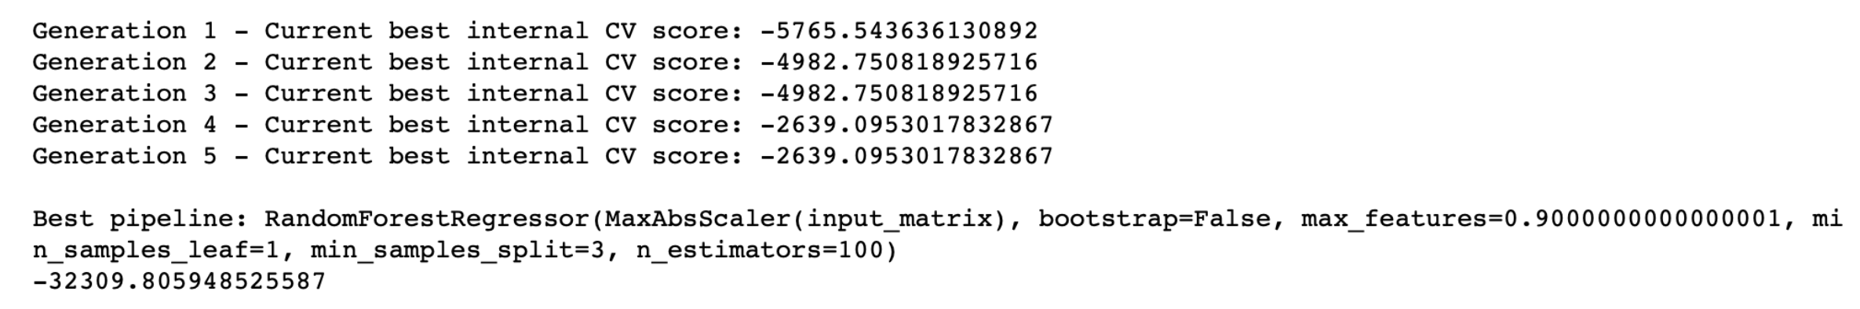
AutoML for regression prediction
Tpot model

Slide 26
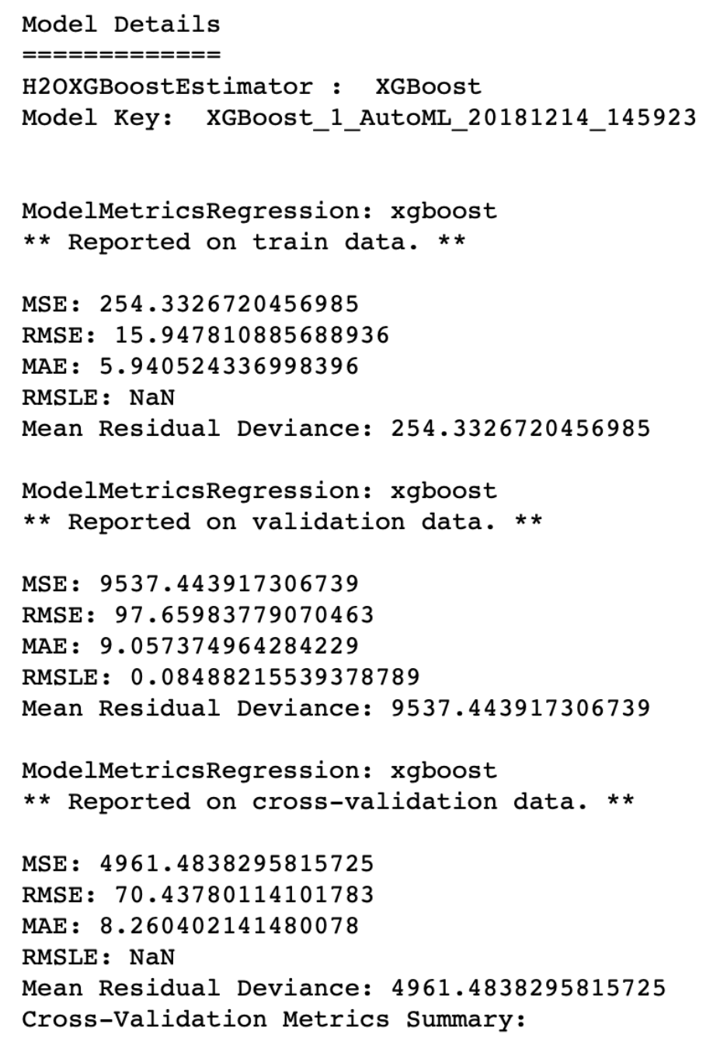

Slide 27
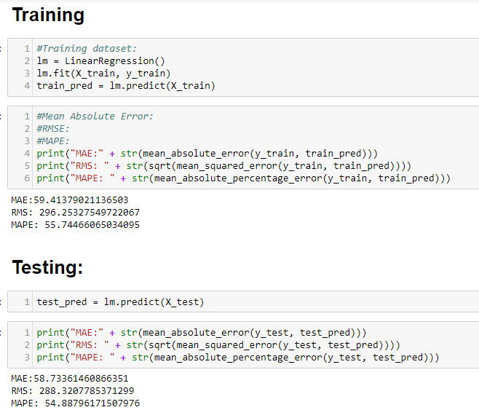
LINEAR REGRESSION

Slide 28
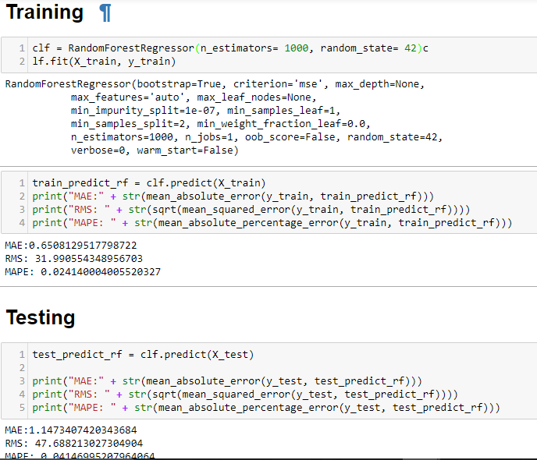
RANDOM FOREST

Slide 29
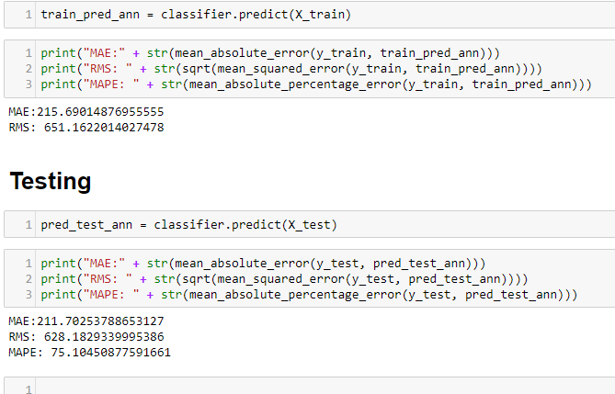
NEURAL NETWORKS (USING KERAS)

Slide 30
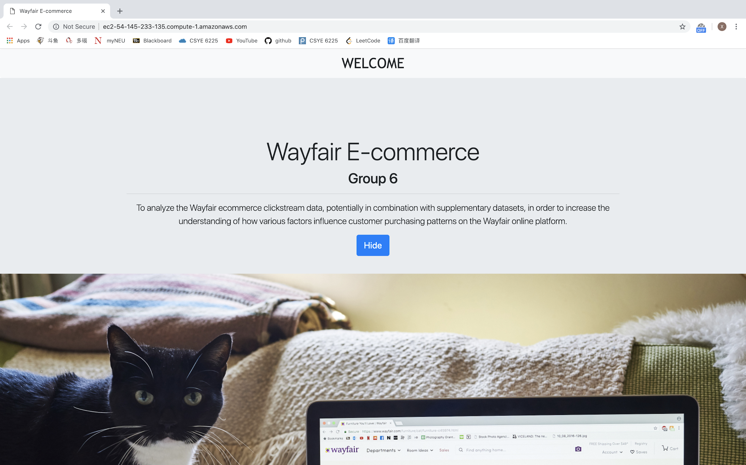
Flask

Slide 31
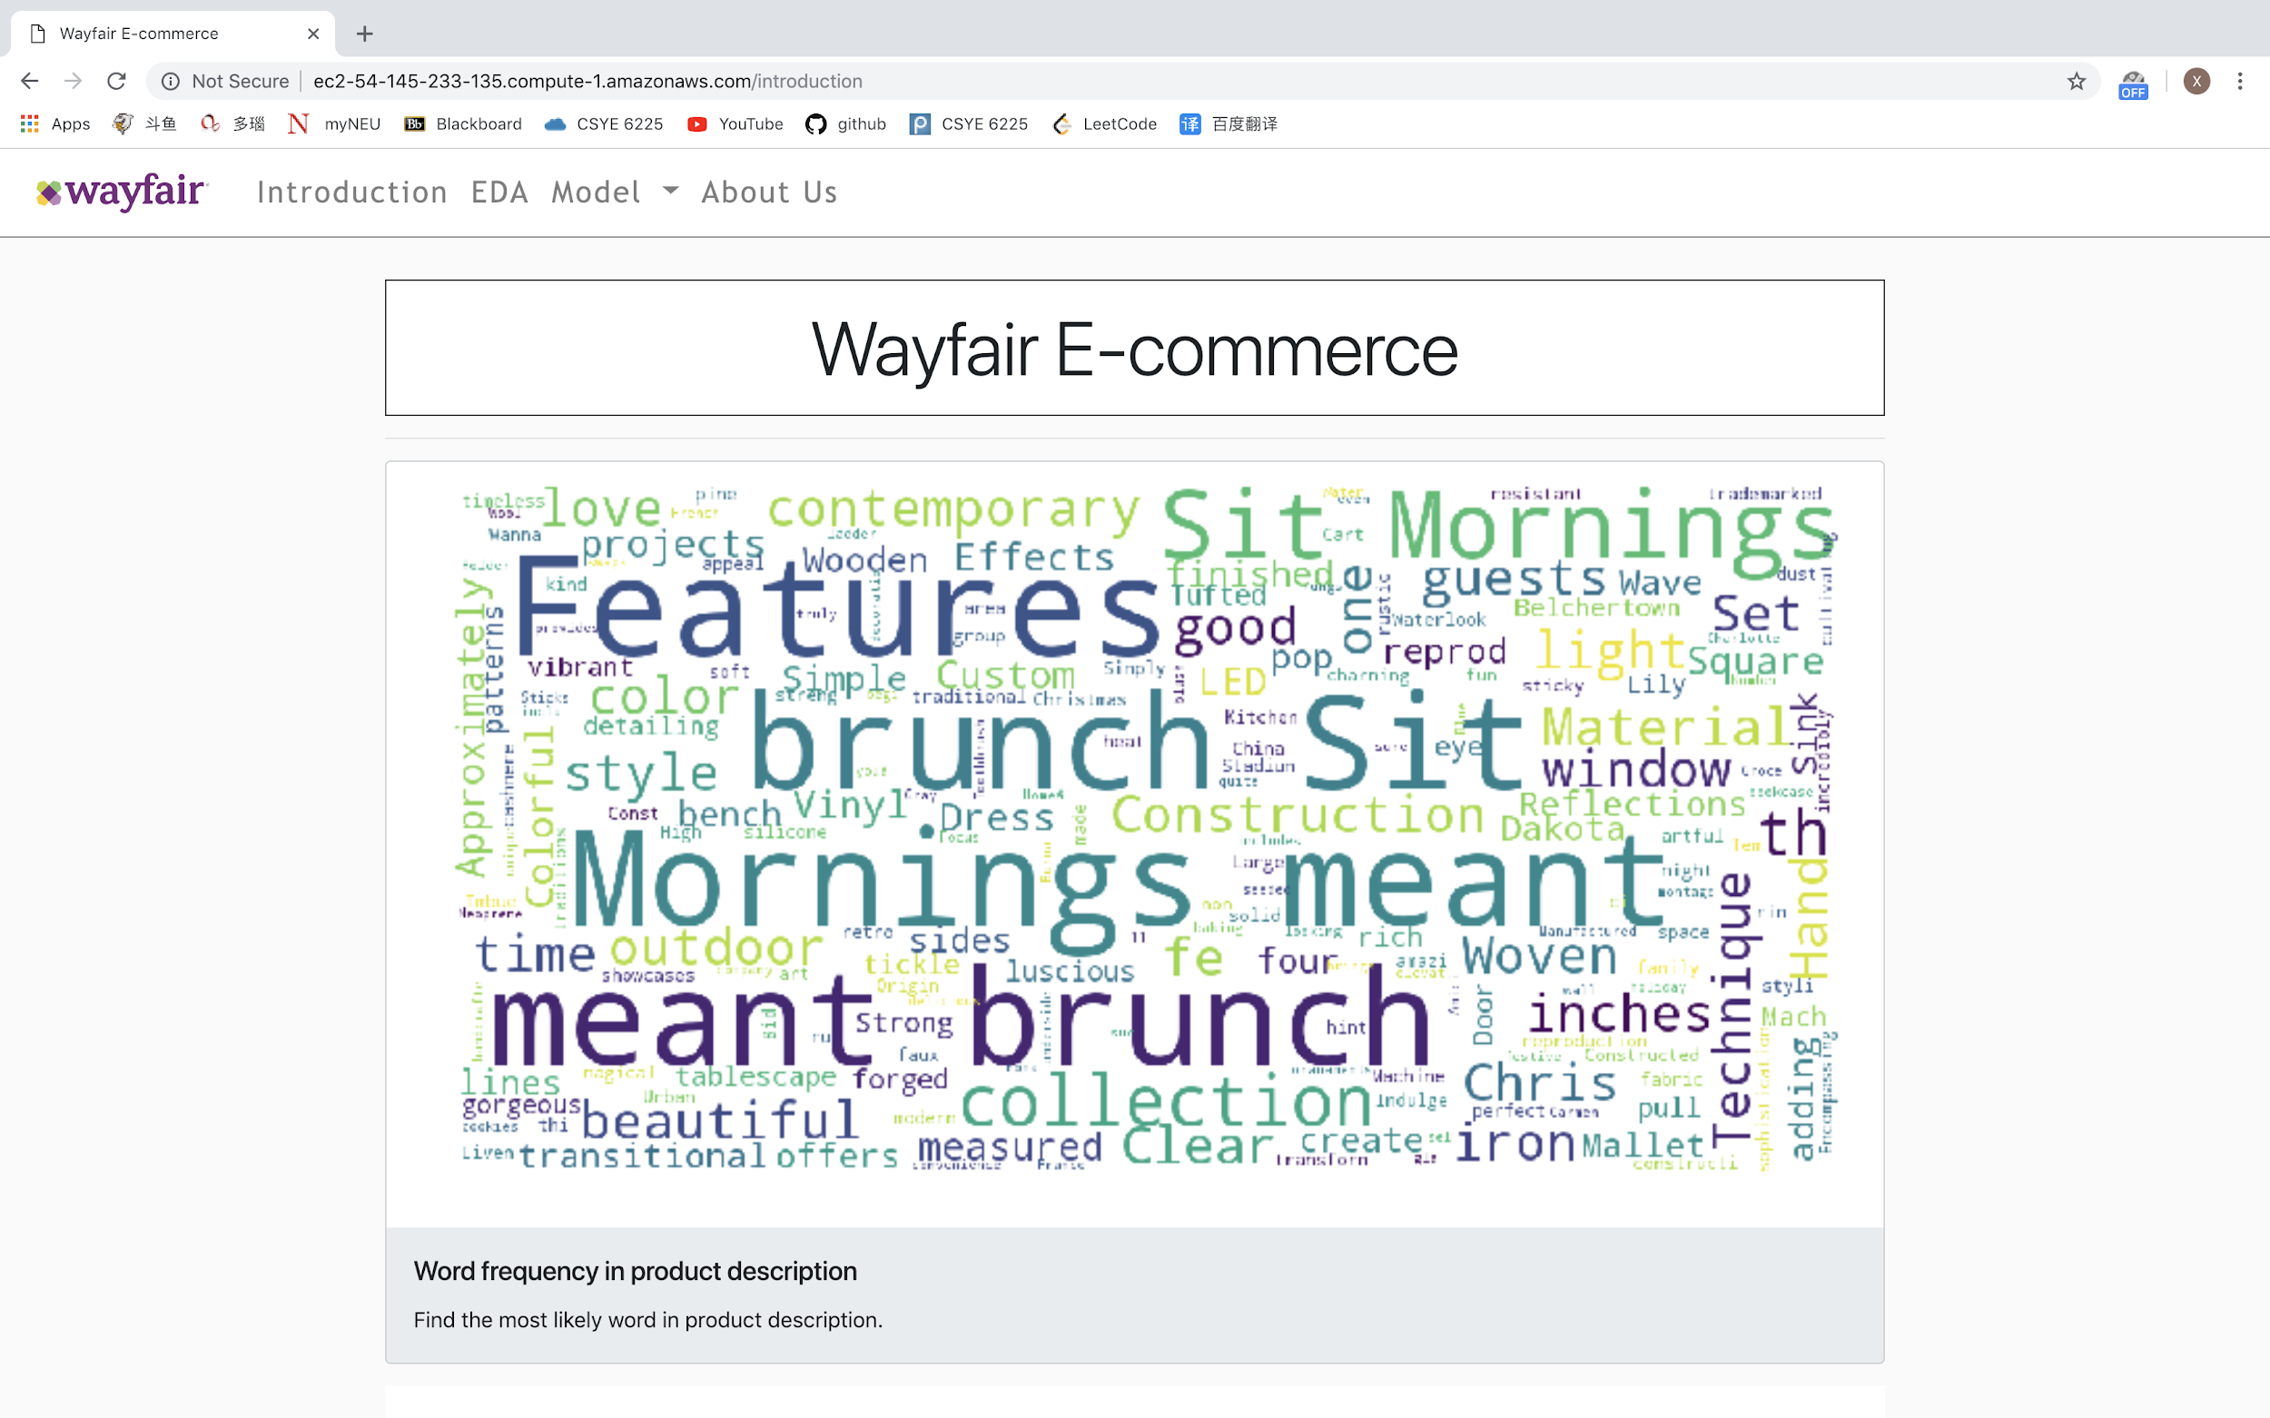

Slide 32
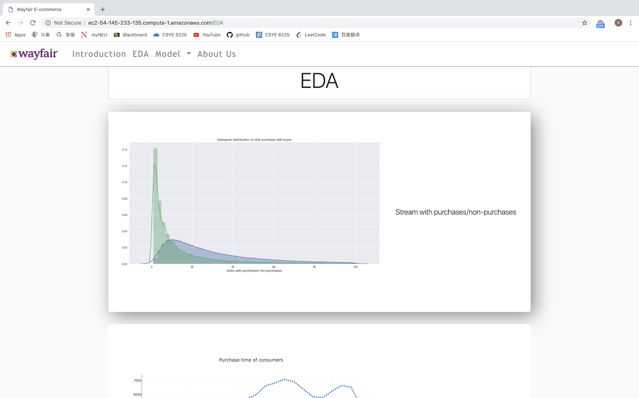

Slide 33
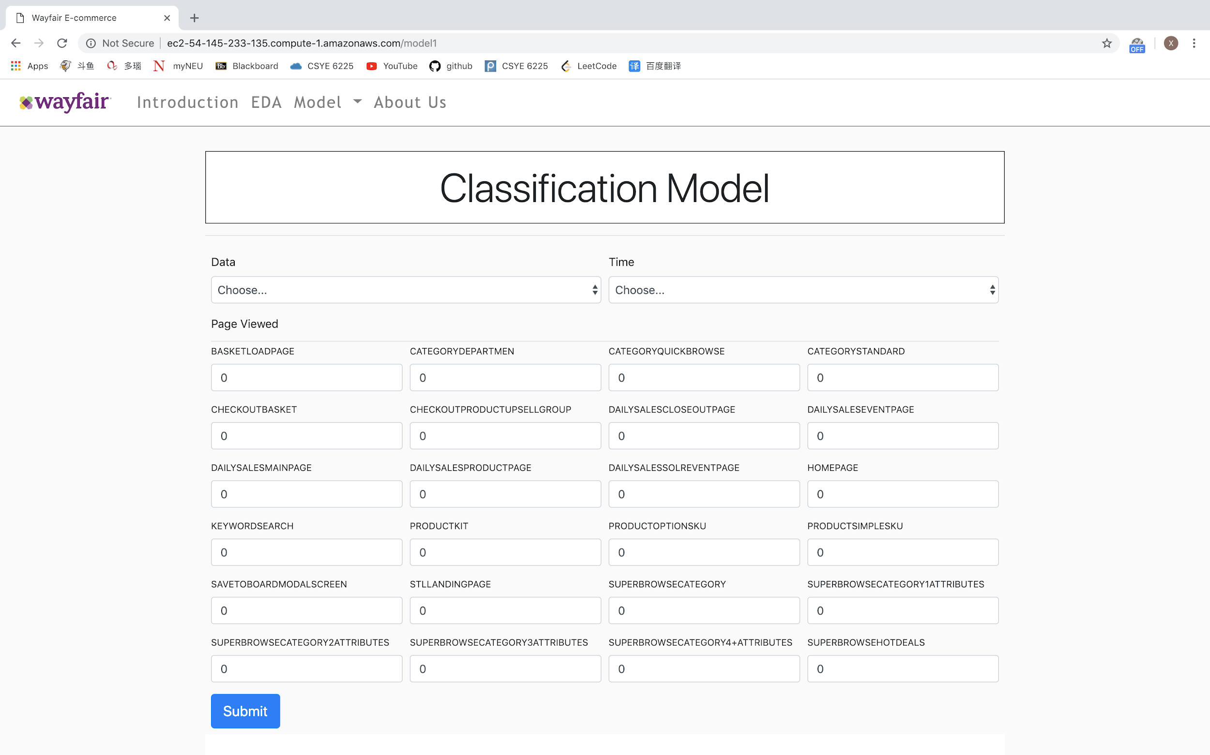

Slide 34
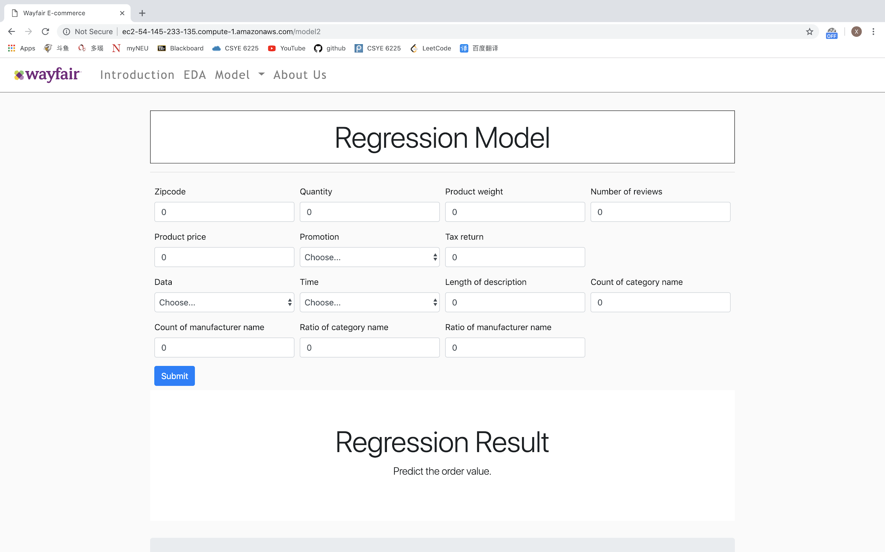

Slide 35
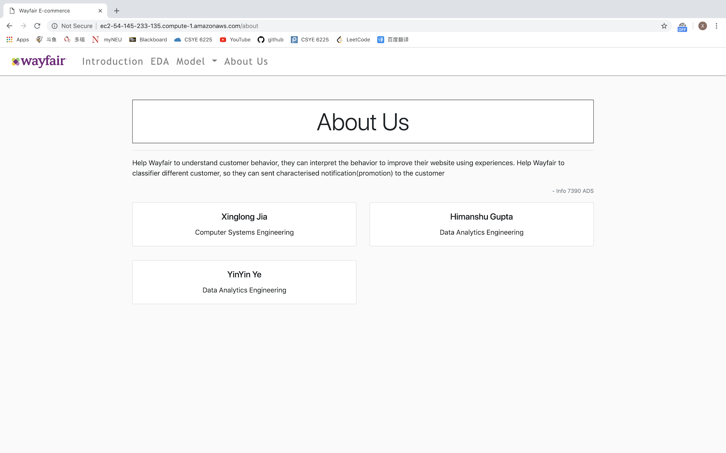

Slide 36
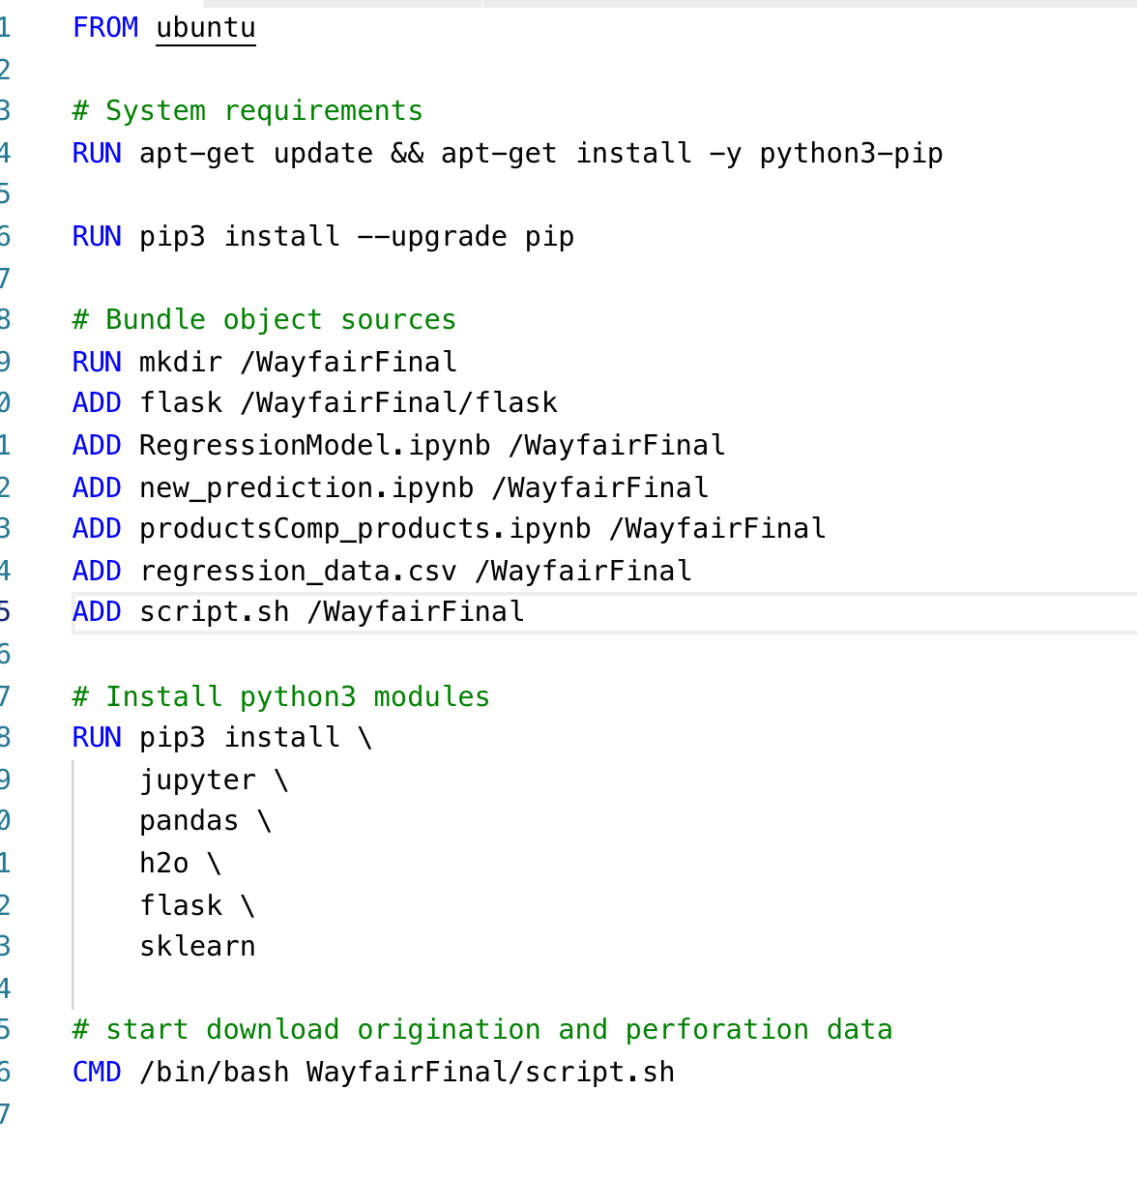
Docker

Slide 37
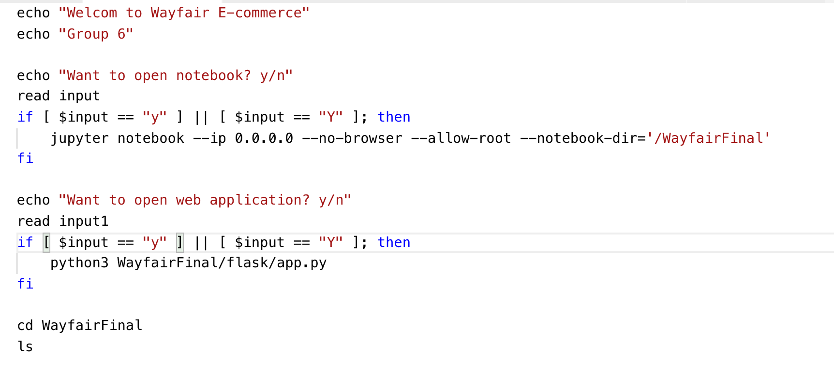

Slide 38
